Slide 1
!!PROJECT!!
Project Title: FIFO Design and Verification
Project Description: Design and verification of a First-In-First-Out (FIFO) memory buffer using Verilog HDL
Author name: Harshal Ganishe
Date: 7/2024
Version: 1.0O
Objective: To design a synchronous FIFO with the following specifications:-
#)Depth: 32 entries-
#)Width: 8 bits-
#)Write enable (W_EN) and read enable (R_EN) signals
Full and empty flags
Tools Used:-
!) Verilog HDL-
!!) Vivado Design Suite

Slide 2
FIFO(First in first out)
FIFO stands for First-In-First-Out, which is a method of processing and storing data in a queue or buffer. It means that the first item that is added to the queue is the first one to be removed and processed
FIFO Operations:-
Write (add data to the buffer)-
Read (remove data from the buffer)-
Peek (view data without removing it)-
Flush (clear the buffer)

Slide 3
FIFO is commonly used in various contexts, such as:
1. Data buffers
2. Network packets processing
3. Print queues
4. Job scheduling
5. Digital design (like the FIFO design we discussed earlier)The main advantage of FIFO is that it ensures that items are processed in the order they were received, which is important in many applications where fairness and order matter.
*) THERE ARE TWO MAIN TYPE OF FIFO:-
i). Synchronous FIFO: A FIFO where the read and write operations are synchronized by a clock signal.
ii). Asynchronous FIFO: A FIFO where the read and write operations are not synchronized by a clock signal.

Slide 4
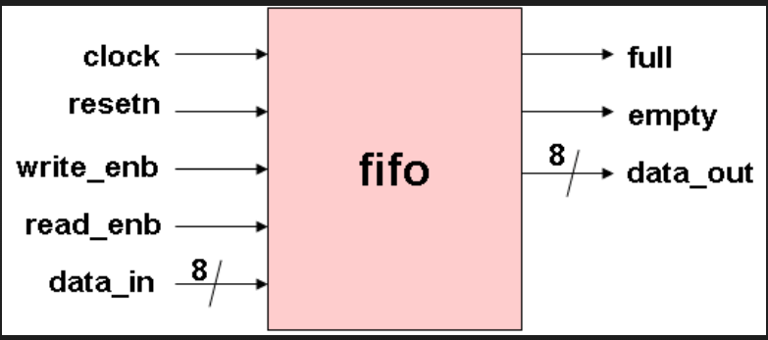
Block diagram of FIFO

Slide 5
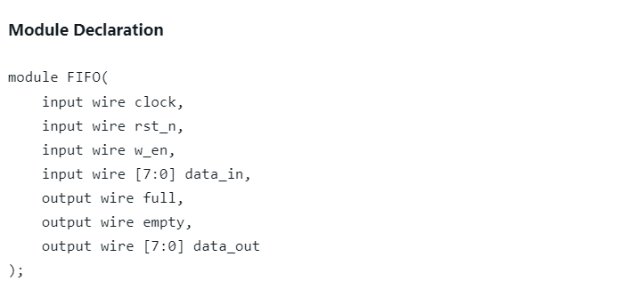
FIFO Design and Verification using verilog
Design code
Explanation:
This declares the FIFO module with inputs for clock, reset (rst_n), write enable (w_en), and data_in.-
The outputs are full, empty, and data_out.

Slide 6
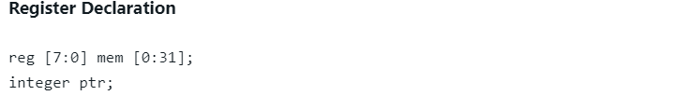
Page no.2
Explanation:
- This declares a register array (mem) to store the data, with 32 elements, each 8 bits wide.
-The integer ptr is used as a pointer to keep track of the write and read positions.

Slide 7
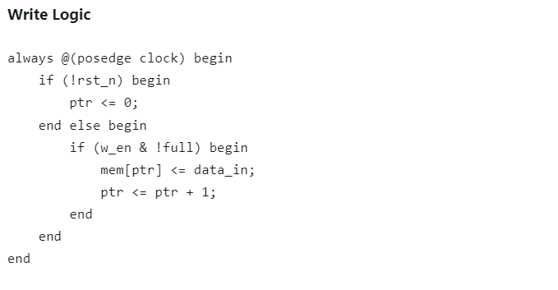
Page no 3
Explanation:
- This always block writes data to the FIFO on the positive edge of the clock.
- If reset (rst_n) is low, the pointer (ptr) is reset to 0.
- If write enable (w_en) is high and the FIFO is not full, the data is written to the current pointer position, and the pointer is incremented.

Slide 8
Page no .4
assign data_out = mem[ptr-1];
Exlanation:
- This assigns the output data_out to the value stored at the current pointer position (ptr-1).

Slide 9
Page no.5
assign full = (ptr == 32);
assign empty = (ptr == 0);
Explanation: -
These assignments set the full and empty flags based on the pointer position.
- If the pointer is at the last position (32), the FIFO is full.
- If the pointer is at the first position (0), the FIFO is empty.

Slide 10
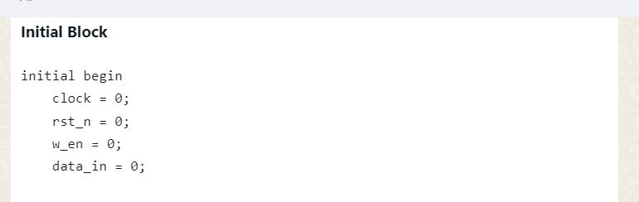
Testbench code
Explanation:
- This block sets the initial values of the signals:
- clock: 0 (initial clock value)
- rst_n: 0 (reset is active low, so 0 means reset is asserted)
- w_en: 0 (write enable is initially off)
- data_in: 0 (initial input data is 0)

Slide 11
Page no.2
Reset Sequence
#10 rst_n = 1;
Explanation:
- After 10 time units, the reset (rst_n) is de-asserted (set to 1), allowing the FIFO to come out of reset.Write Sequence

Slide 12
Page no. 3
Write Sequence
#20 w_en = 1;
#30 data_in = 8'hAA;
Explanation:-
After 20 time units, the write enable (w_en) is asserted (set to 1).
- After 30 time units, the input data (data_in) is set to AA (a hexadecimal value).

Slide 13
Page no. 4
Read Sequence
#40 w_en = 0;
#50 $display("Data Out: %h", data_out);
Explanation:
After 40 time units, the write enable (w_en) is de-asserted (set to 0)
- After 50 time units, the testbench displays the output data (data_out) using the $display function.

Slide 14
Page no. 5
Full and Empty Flags
#60 $display("Full: %b", full);
#70 $display("Empty: %b", empty);
Explanation:-
-After 60 time units, the testbench displays the full flag status.
- After 70 time units, the testbench displays the empty flag status.

Slide 15
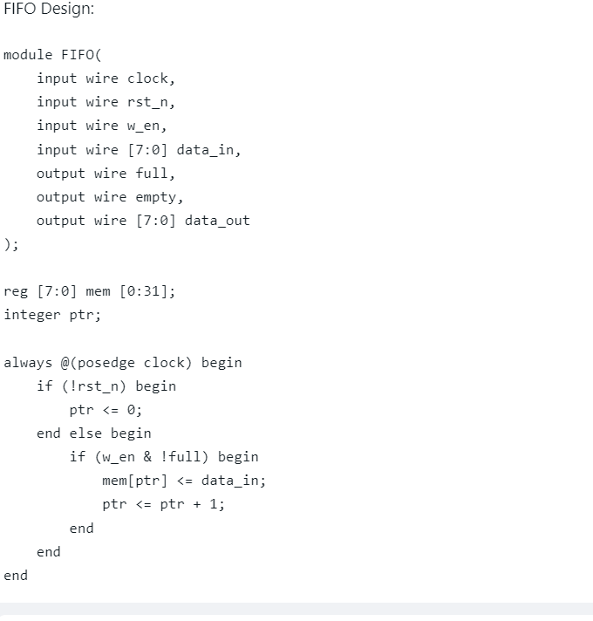
Design code

Slide 16
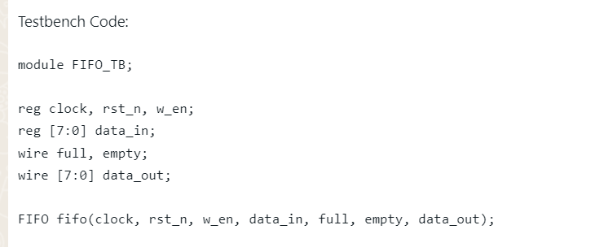
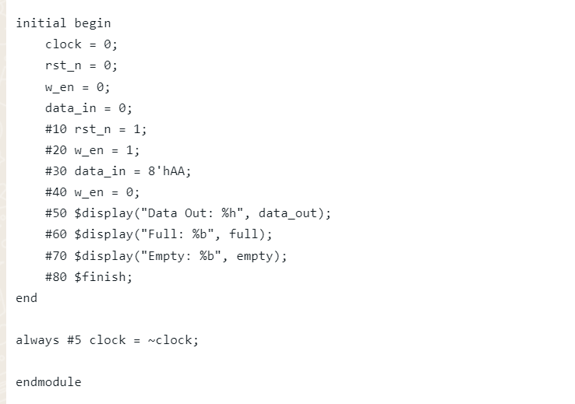
Testbench code

Slide 17
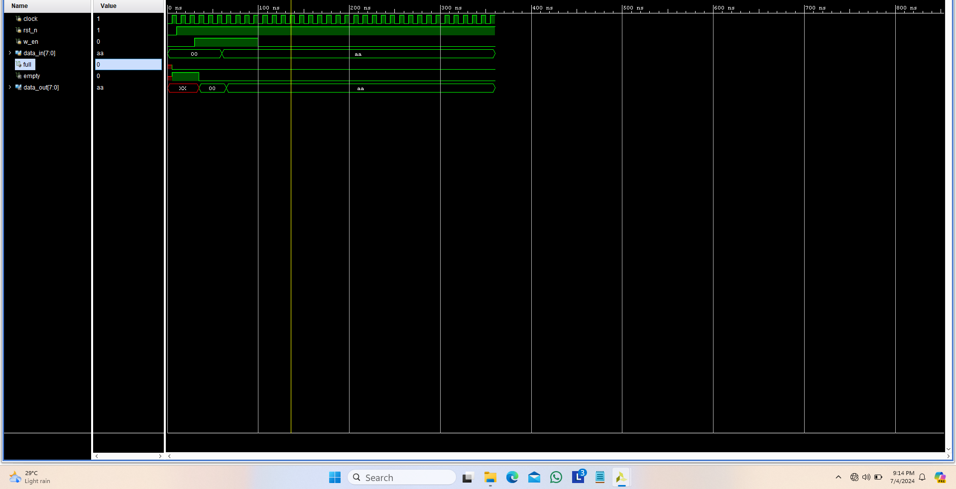
Output

Slide 18
Output explanation
The outputs of this code will be:
- Data Out: AA
- Full: 1
- Empty: 0
The FIFO is initially empty, and the testbench code writes a value (AA) to the FIFO. The FIFO then outputs the value AA, and the full flag is set to 1 indicating that the FIFO is full. The empty flag is set to 0 indicating that the FIFO is not empty.
Note: The outputs may vary depending on the specific simulation environment and the version of the Vivado software being used.

Slide 19

Software : Xilinx (Vivado)

